Slide 1

Web Application Development
COMP-229
Fall 2023

Slide 2
Introduction to MEAN and MERN
Objectives:
Describe MEAN and MERN stack architecture.
Install and run MongoDB.
Install and run Node.js
Create simple Node.js apps in Visual Studio Code

Slide 3
Three-tier web application development
The three-tier architecture consists of three important layers: data services, business logic, and presentation.
In the MVC paradigm, the logic, data, and visualization are separated into three types of objects:
View - handles UI
Model - handles the data manipulation
Controller - controls the model and view

Slide 4
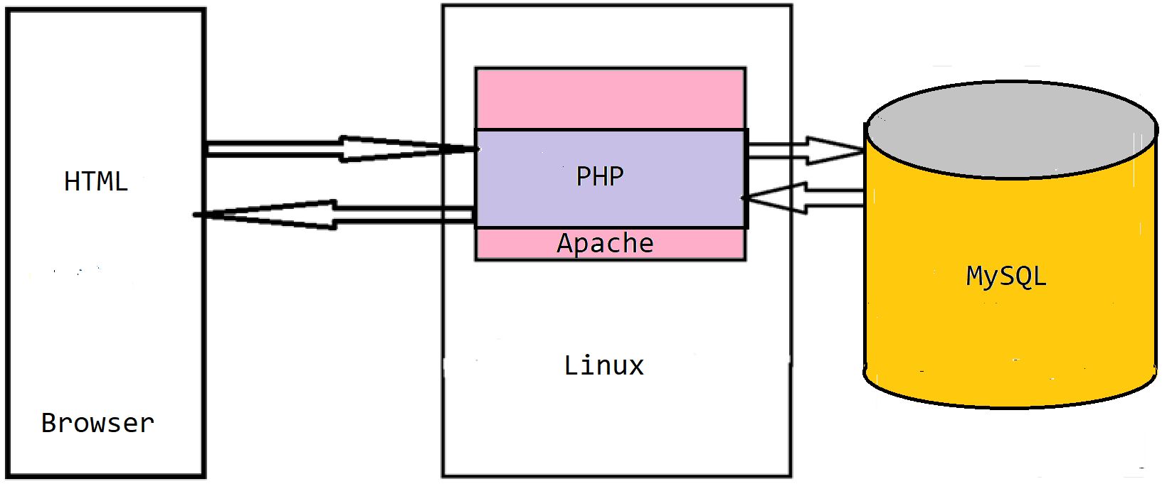
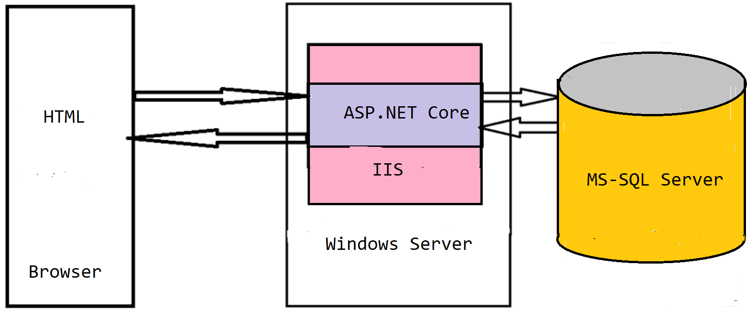
Web technology stacks - recap
LAMP stack:
Linux
Apache
MySQL
PHP/Python/Perl
.NET (Core) stack:
.NET (Core)
IIS
ASP.NET (Core)
Web API and WCF
MS-SQL Server
Other frameworks and tools (Django, Flask, etc.)
Each layer uses a different knowledge base!

Slide 5
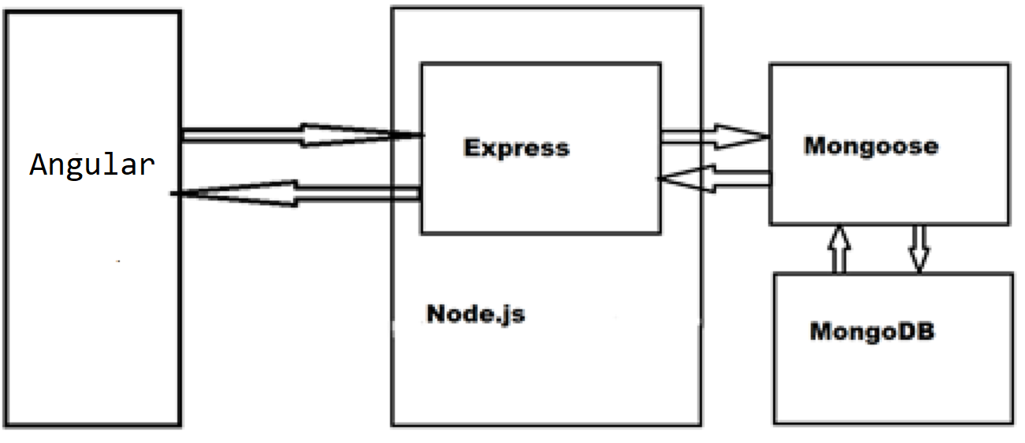
MEAN Stack - recap
MEAN is an abbreviation for MongoDB, Express, AngularJS, and Node.js.
Uses only JavaScript - driven solutions to implement the different parts of a web application.
Has the following advantages:
A single language is used throughout the application
All the parts of the application can support and often enforce the use of the MVC architecture
Serialization and deserialization of data structures is no longer needed because data marshaling is done using JSON objects.

Slide 6
MEAN Stack - recap
MongoDB is a scalable NoSQL database that used a JSON-like data model with dynamic schemas.
Express is a lightweight node.js web application framework, providing a robust set of features for building single and multi-page, and hybrid web application.
Node.js is a server side JavaScript execution environment built on Google Chrome’s V8 JavaScript runtime - helps in building highly scalable and concurrent applications rapidly.
Angular is a JavaScript framework developed by Google - a complete solution for rapid front end development.

Slide 7
LAMP versus MEAN - recap
Linux ➔ Node.js (platform)
Apache ➔ Express.js (web server framework)
MySQL ➔ MongoDB (persistence layer)
PHP or Python or Perl ➔ Angular (User Interface)

Slide 8
Full-Stack JavaScript Advantages - recap
High Performance
Increasing number of requests
Reducing response time
Non-blocking I/O - allows web server to handle more concurrent requests without requiring additional hardware or configuration
Cross-platform (Windows, Linux, MacOS)
One single programming language for the entire project

Slide 9
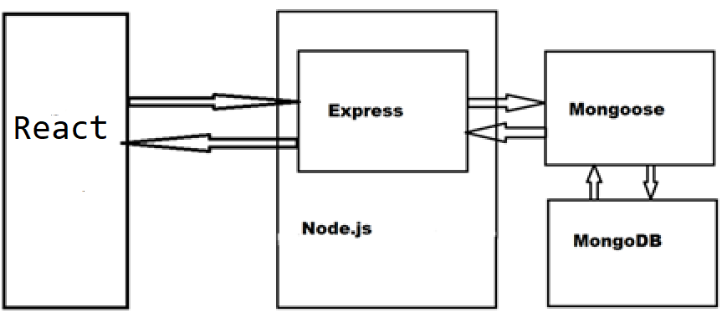
MERN Stack - recap
MongoDB
Express
Node.js
ReactJS is a JavaScript component-based front-end library maintained by Facebook – most popular for front-end development.

Slide 10
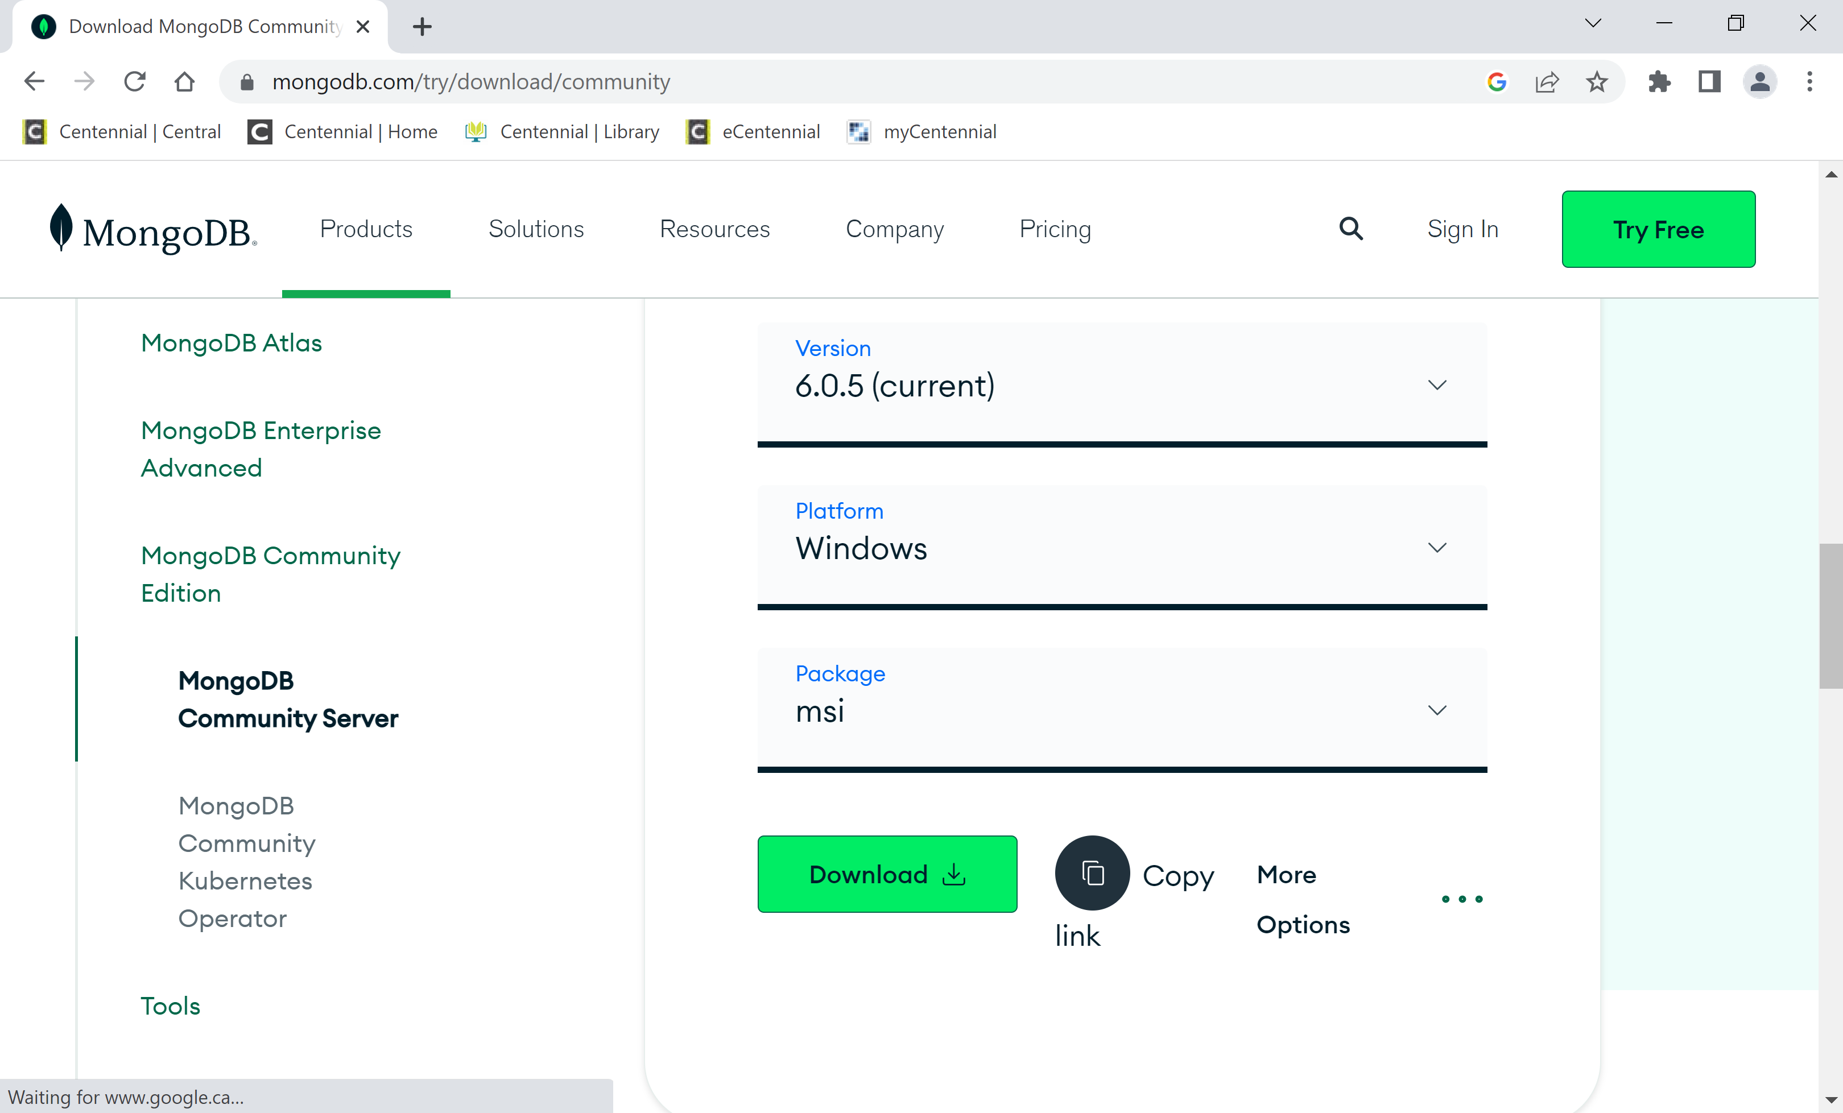
Downloading MongoDB

Slide 11
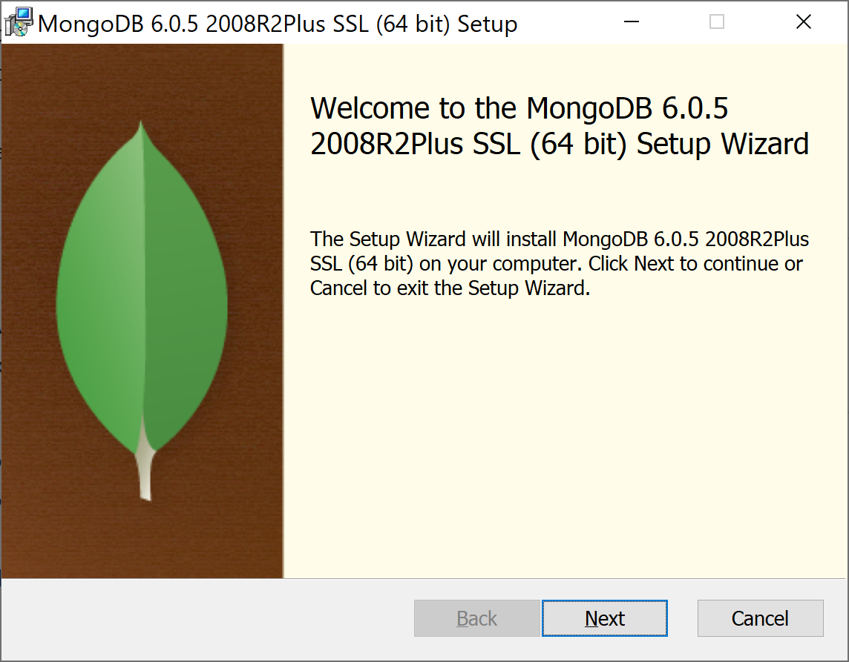
Installing MongoDB

Slide 12
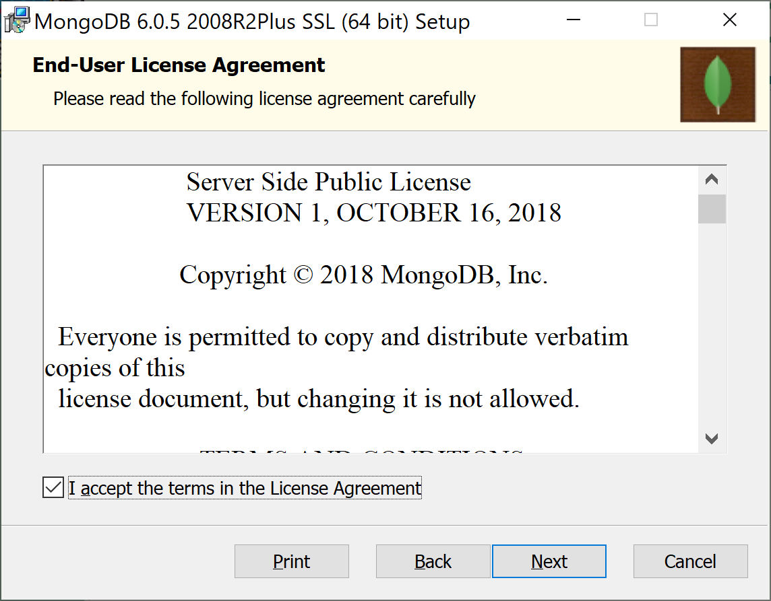
Installing MongoDB

Slide 13
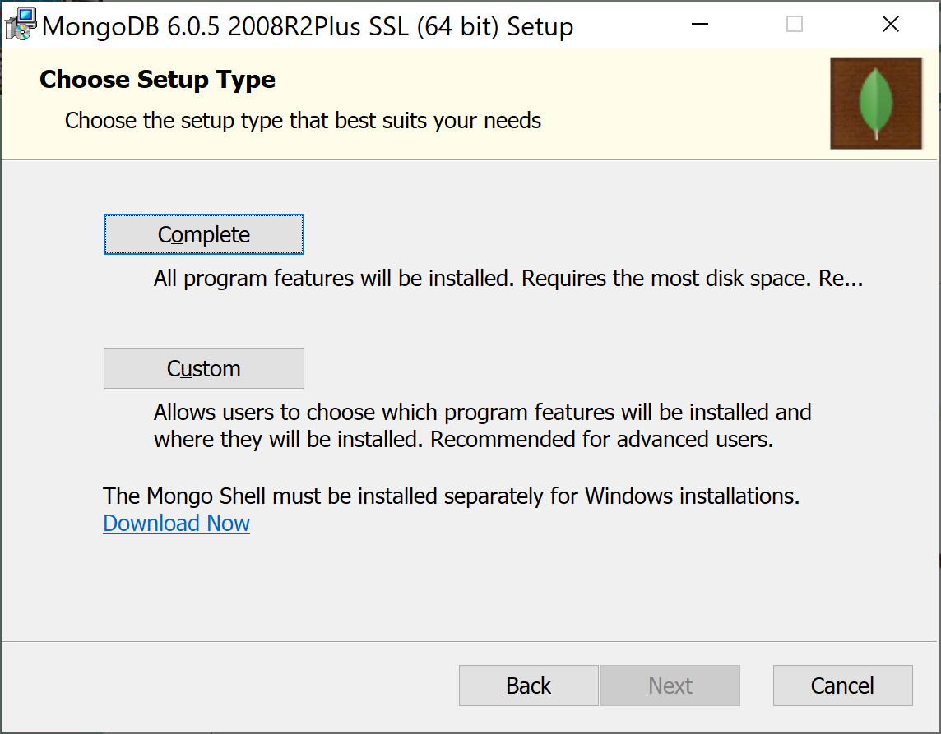
Installing MongoDB

Slide 14
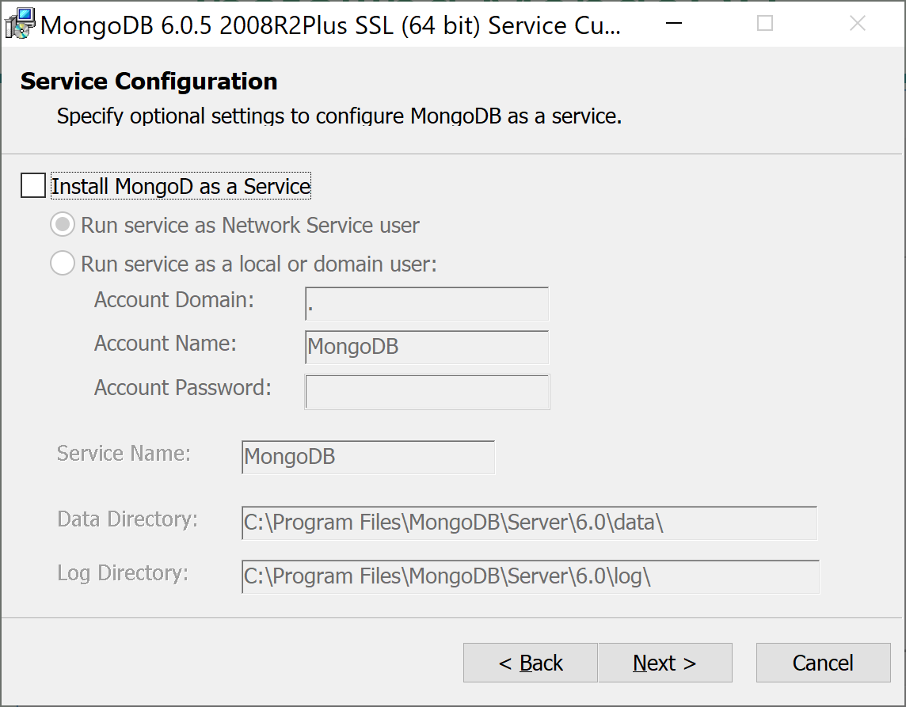
Installing MongoDB

Slide 15
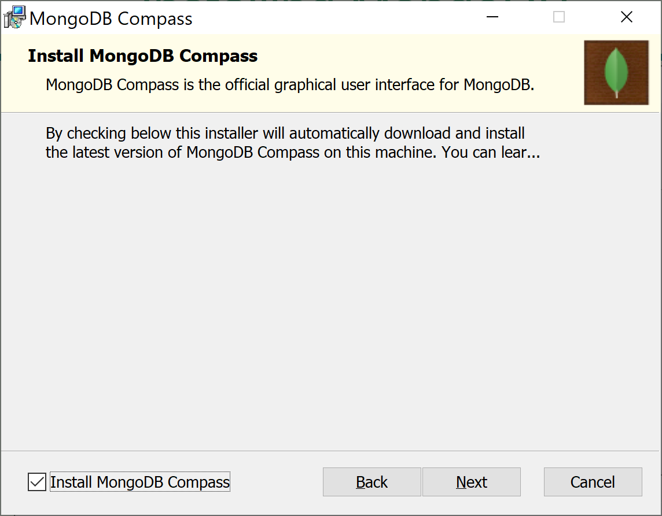
Installing MongoDB

Slide 16
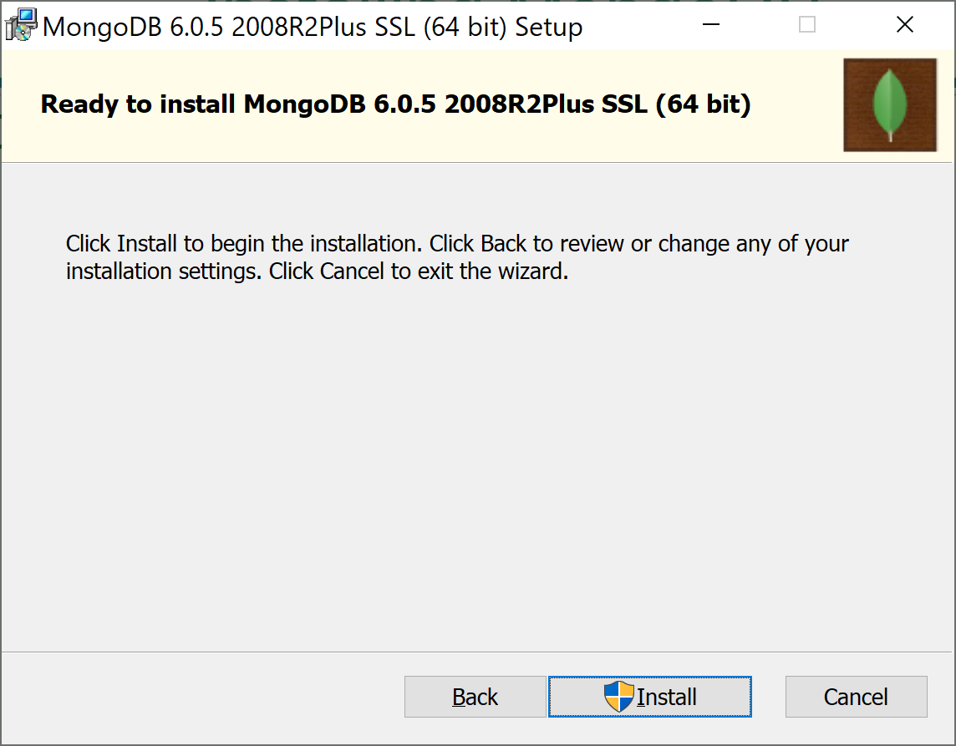
Installing MongoDB

Slide 17
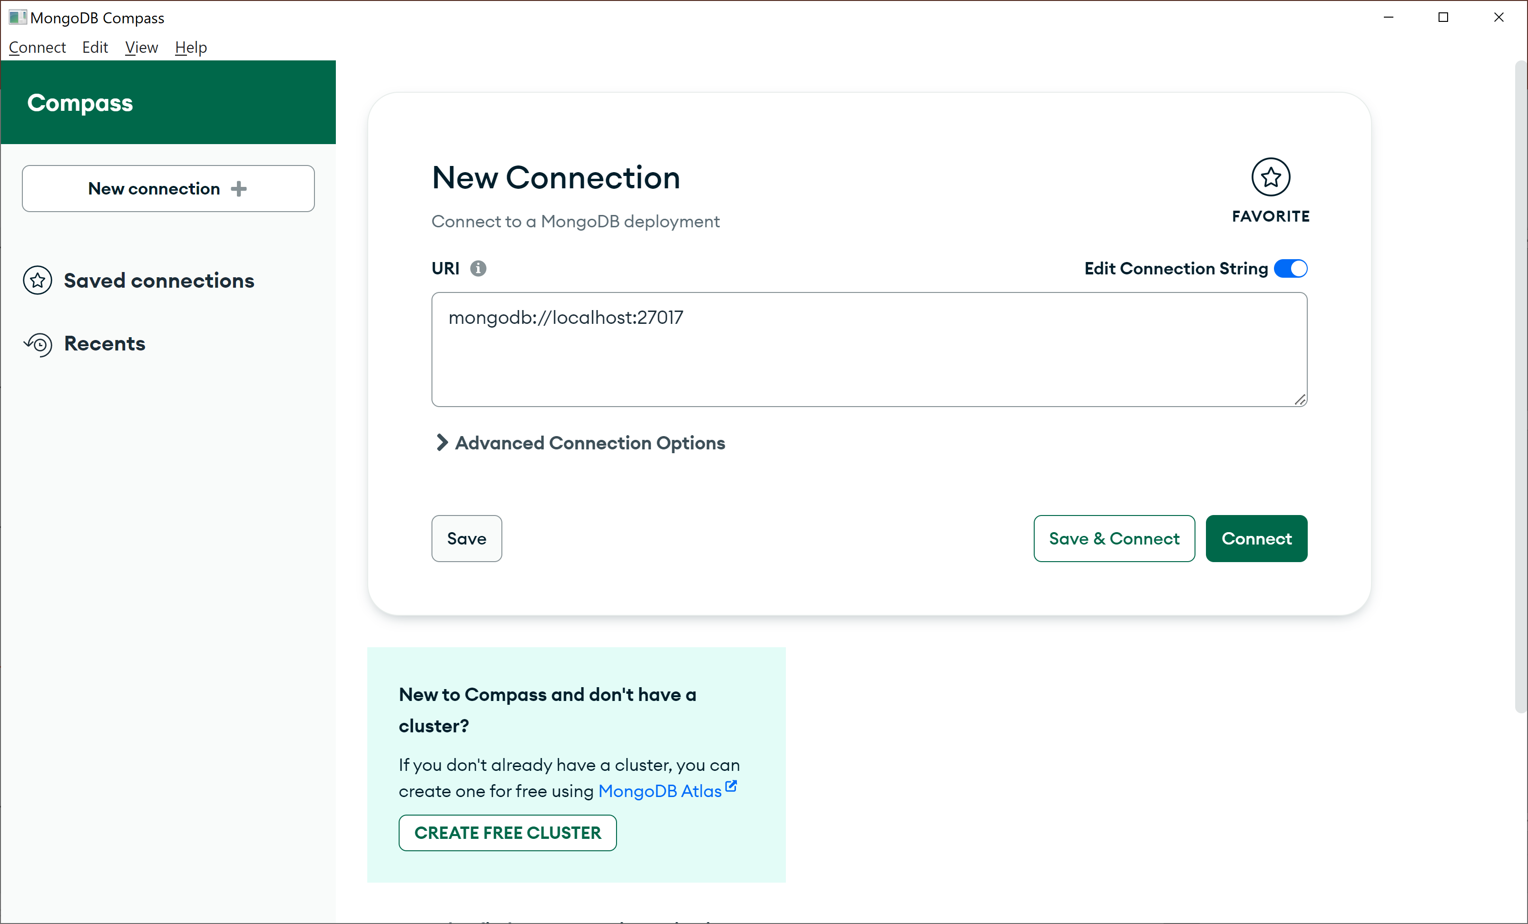
Installing MongoDB

Slide 18
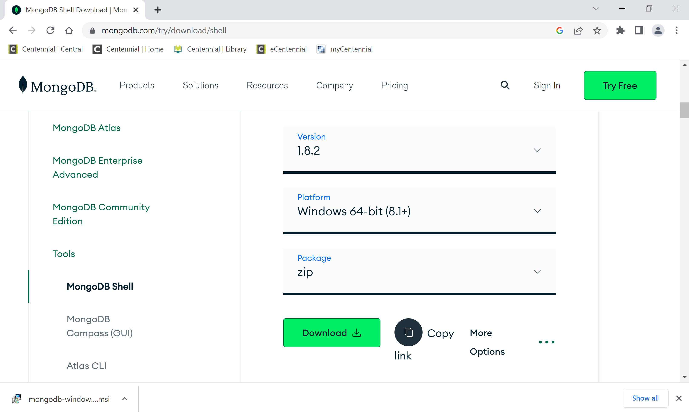
Install mongosh

Slide 19
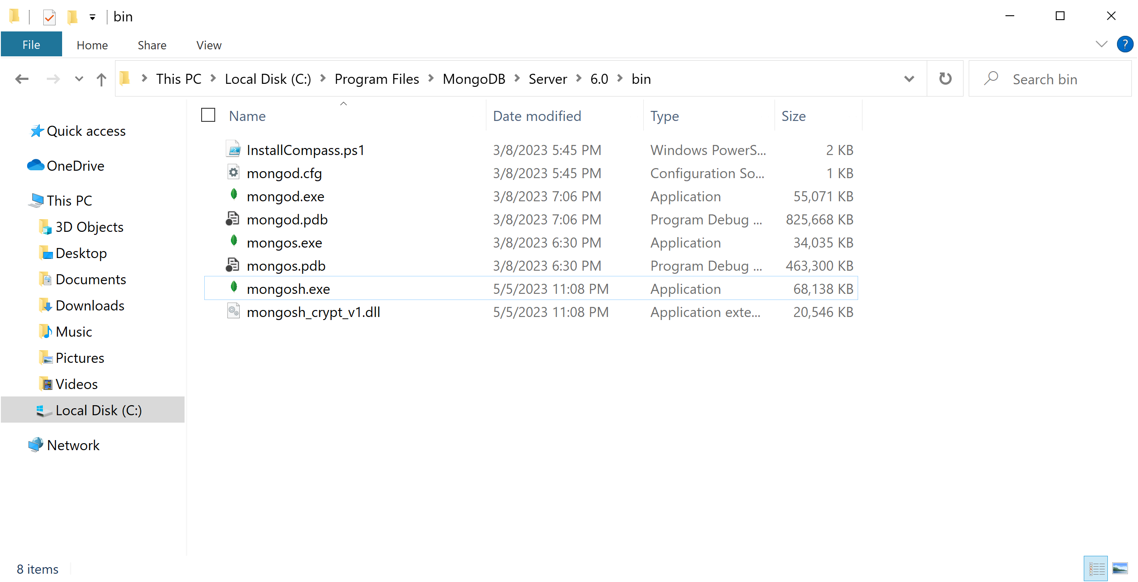
MongoDB bin folder

Slide 20
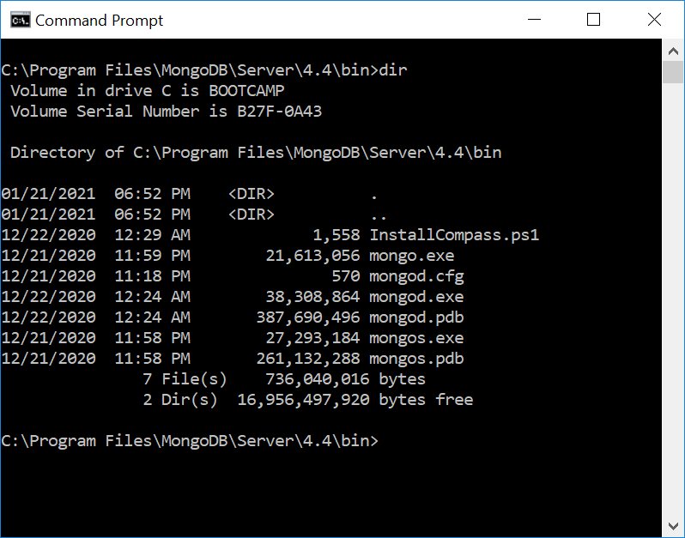
MongoDB bin folder

Slide 21
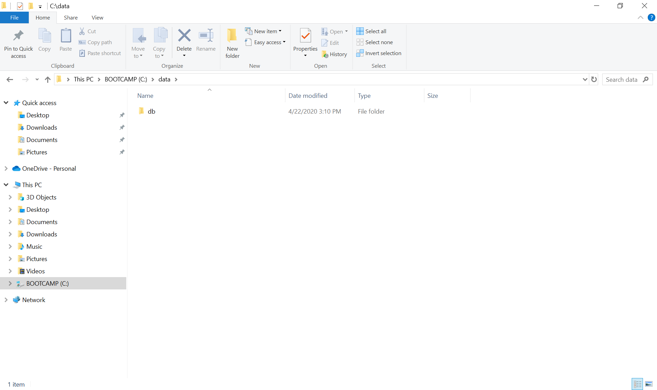
MongoDB default folder for files
Create MongoDB default folder to store its files - on Windows, the default location is C:\data\db:

Slide 22
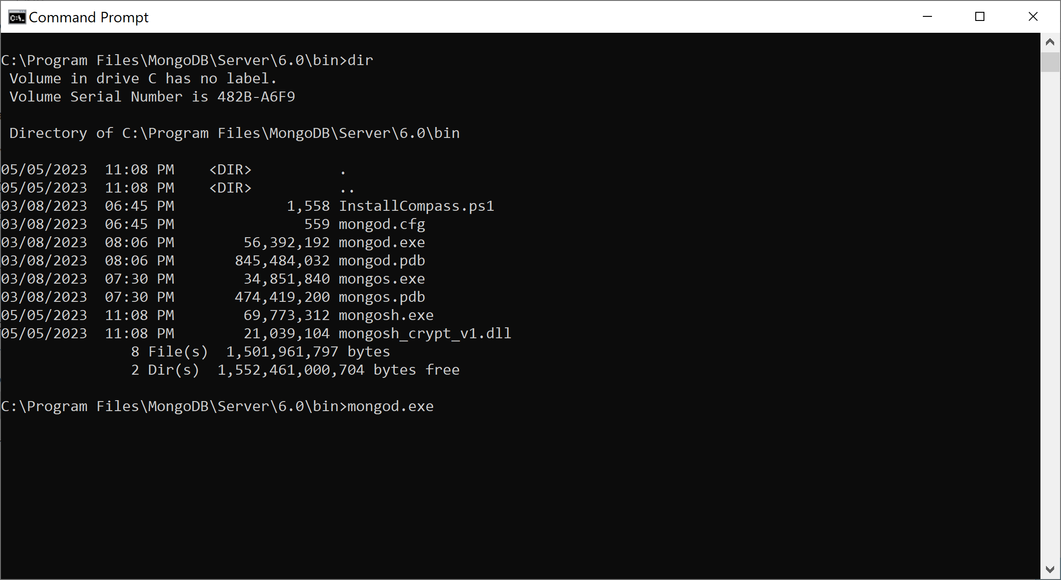
Running MongoDB
Open the command prompt and execute the following command: "C:\Program Files\MongoDB\Server\6.0\bin\mongod.exe", or run mongod from the bin directory:

Slide 23
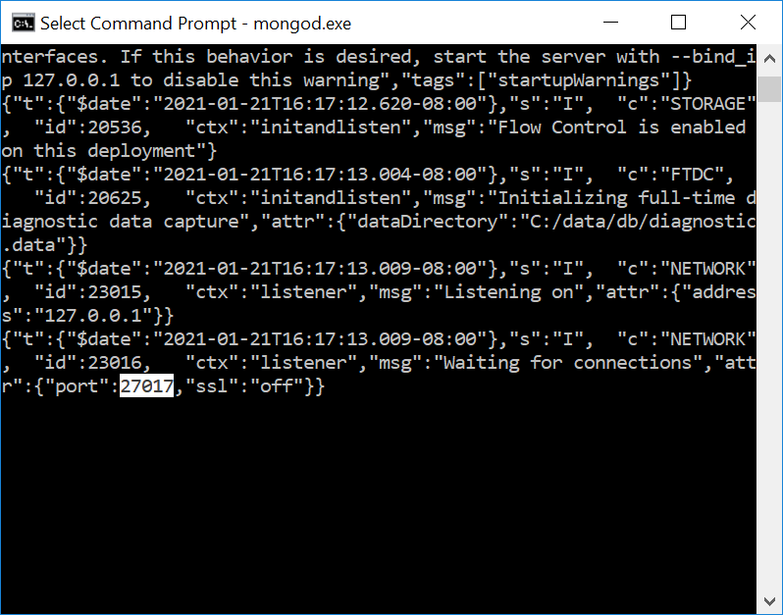
Running MongoDB
The main MongoDB service will start listening to the default 27017 port:

Slide 24

Using the MongoDB shell
MongoDB shell allows to you to interact with your server instance using the command line.
To start the shell, navigate to the MongoDB bin folder and run the mongosh service as follows:

Slide 25
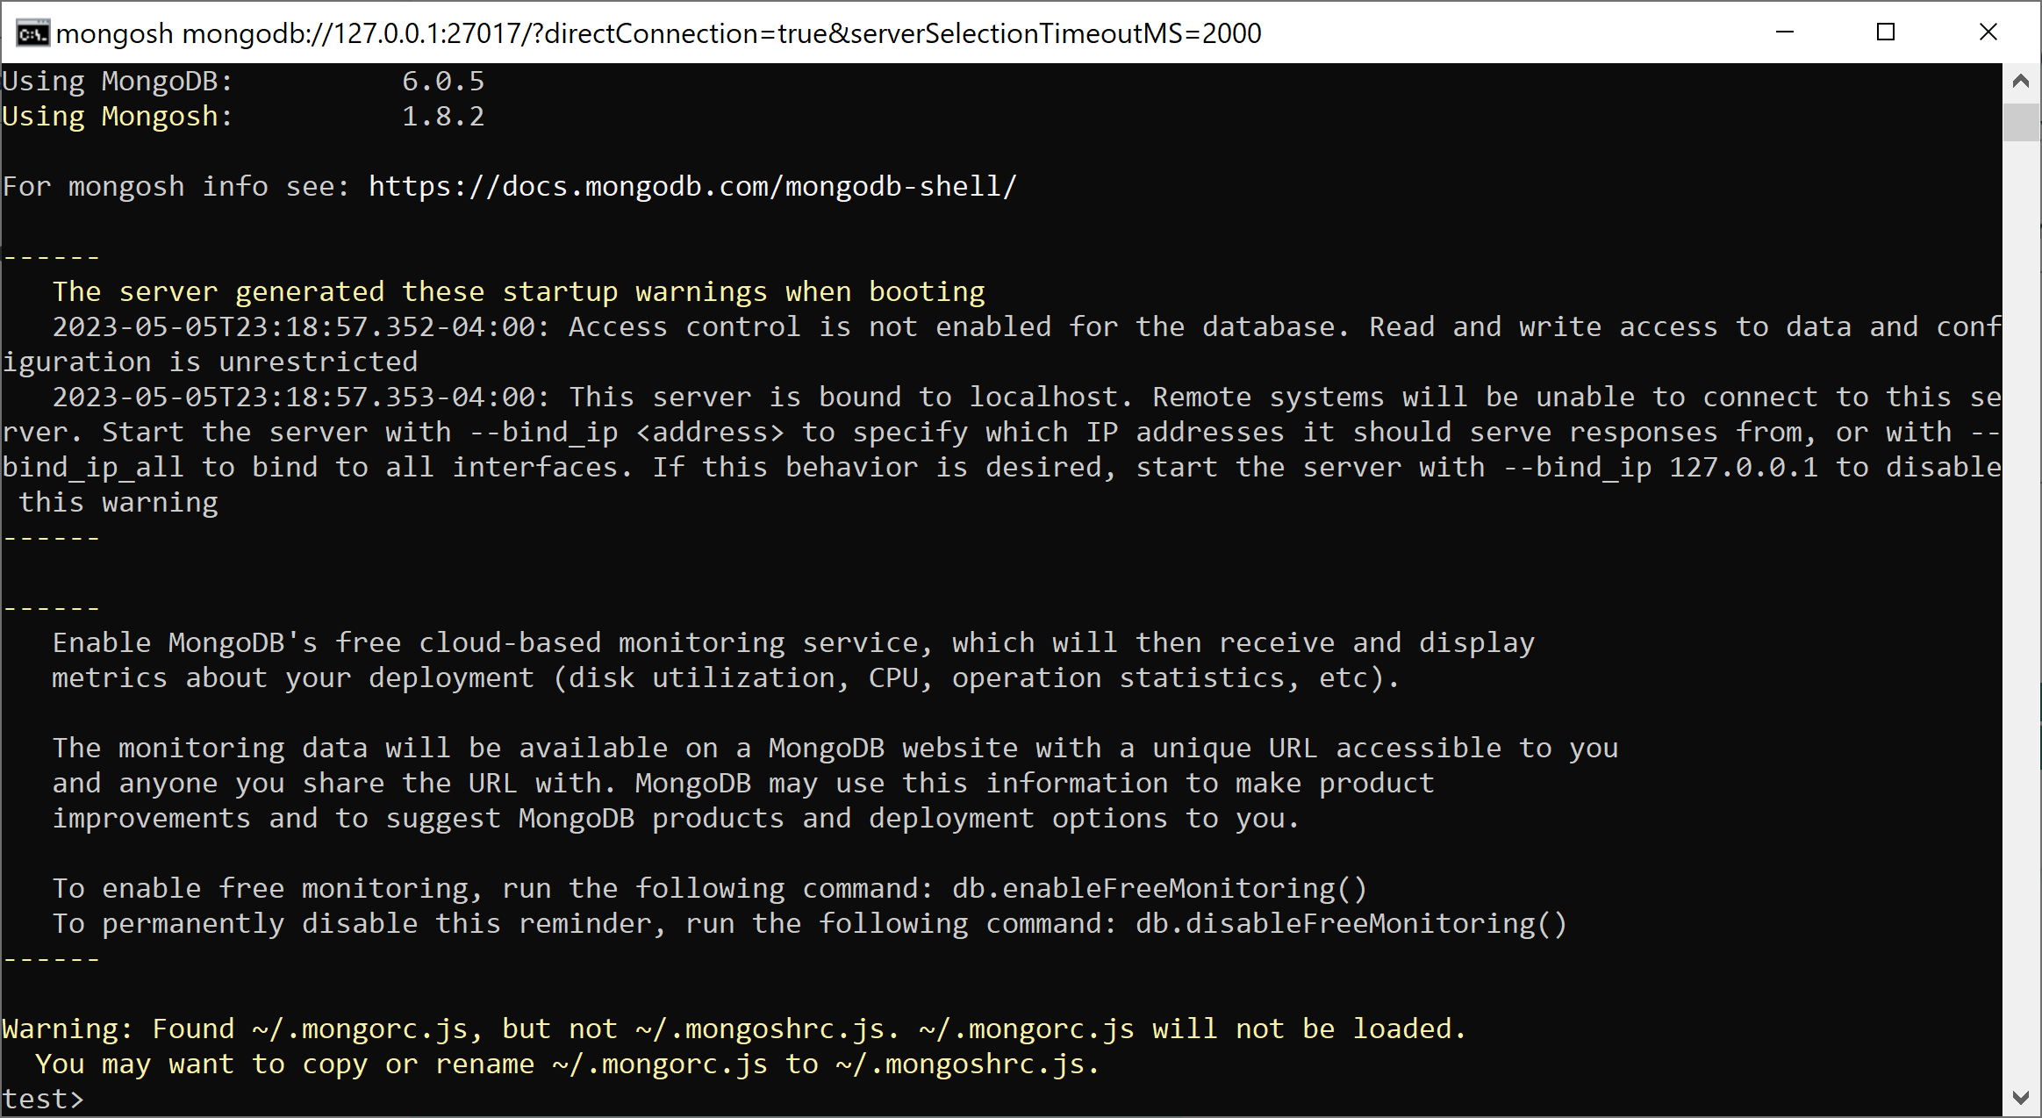
Using the MongoDB shell

Slide 26
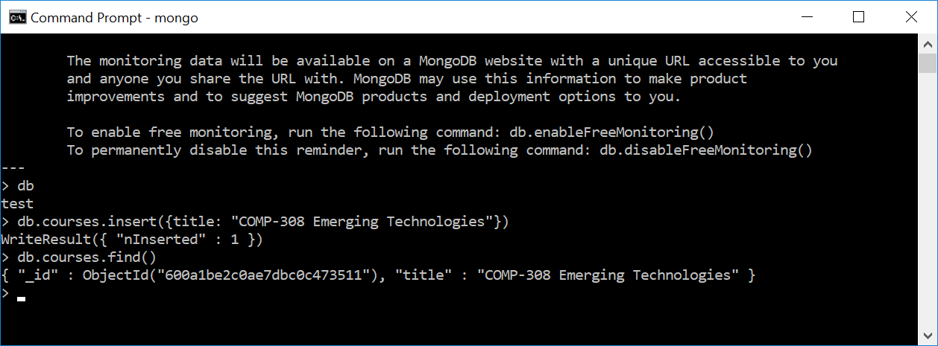
Testing the database
To test your database, run the following command:
> db.courses.insert({title: "COMP-308 Emerging Technologies"}).
To retrieve the course object, execute the following command:
> db.courses.find()

Slide 27
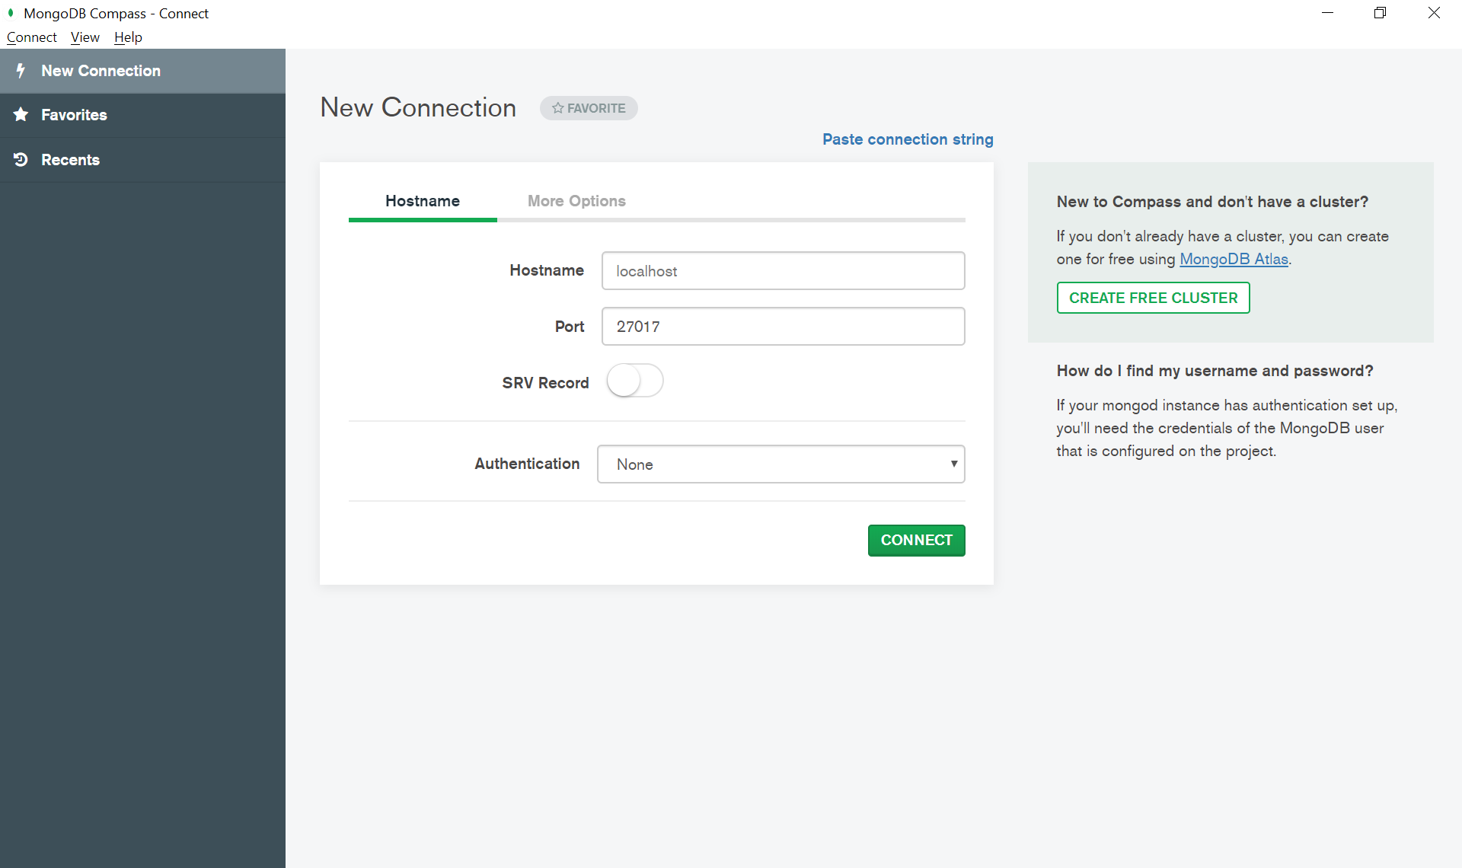
MongoDB Compass

Slide 28
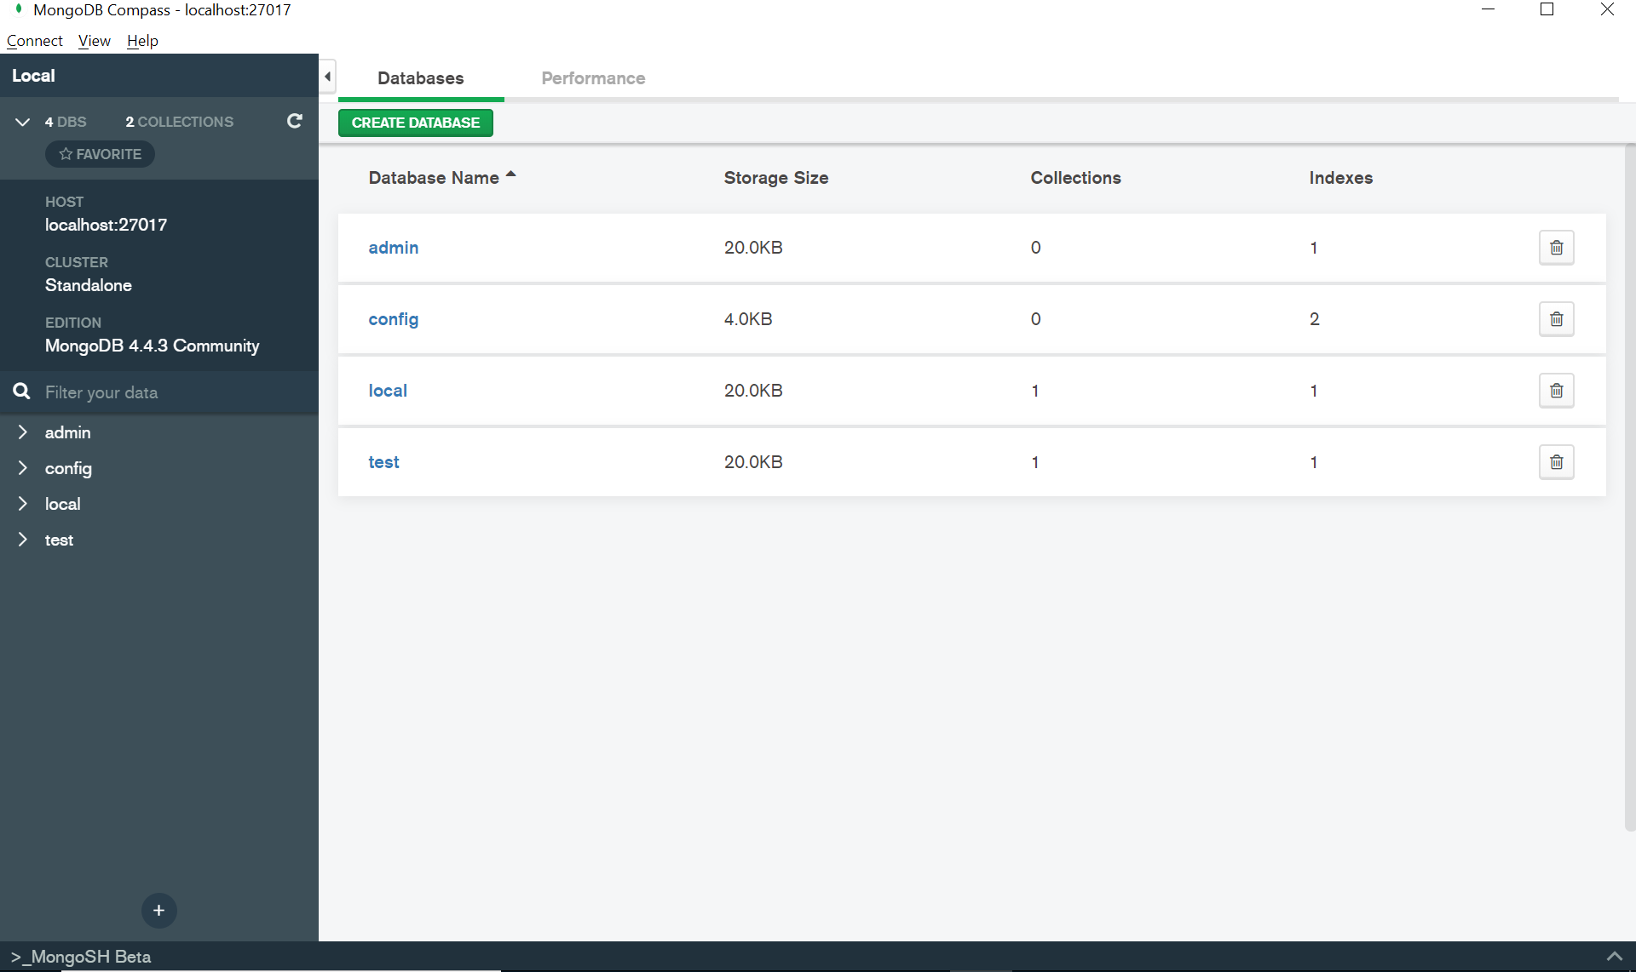
MongoDB Compass

Slide 29
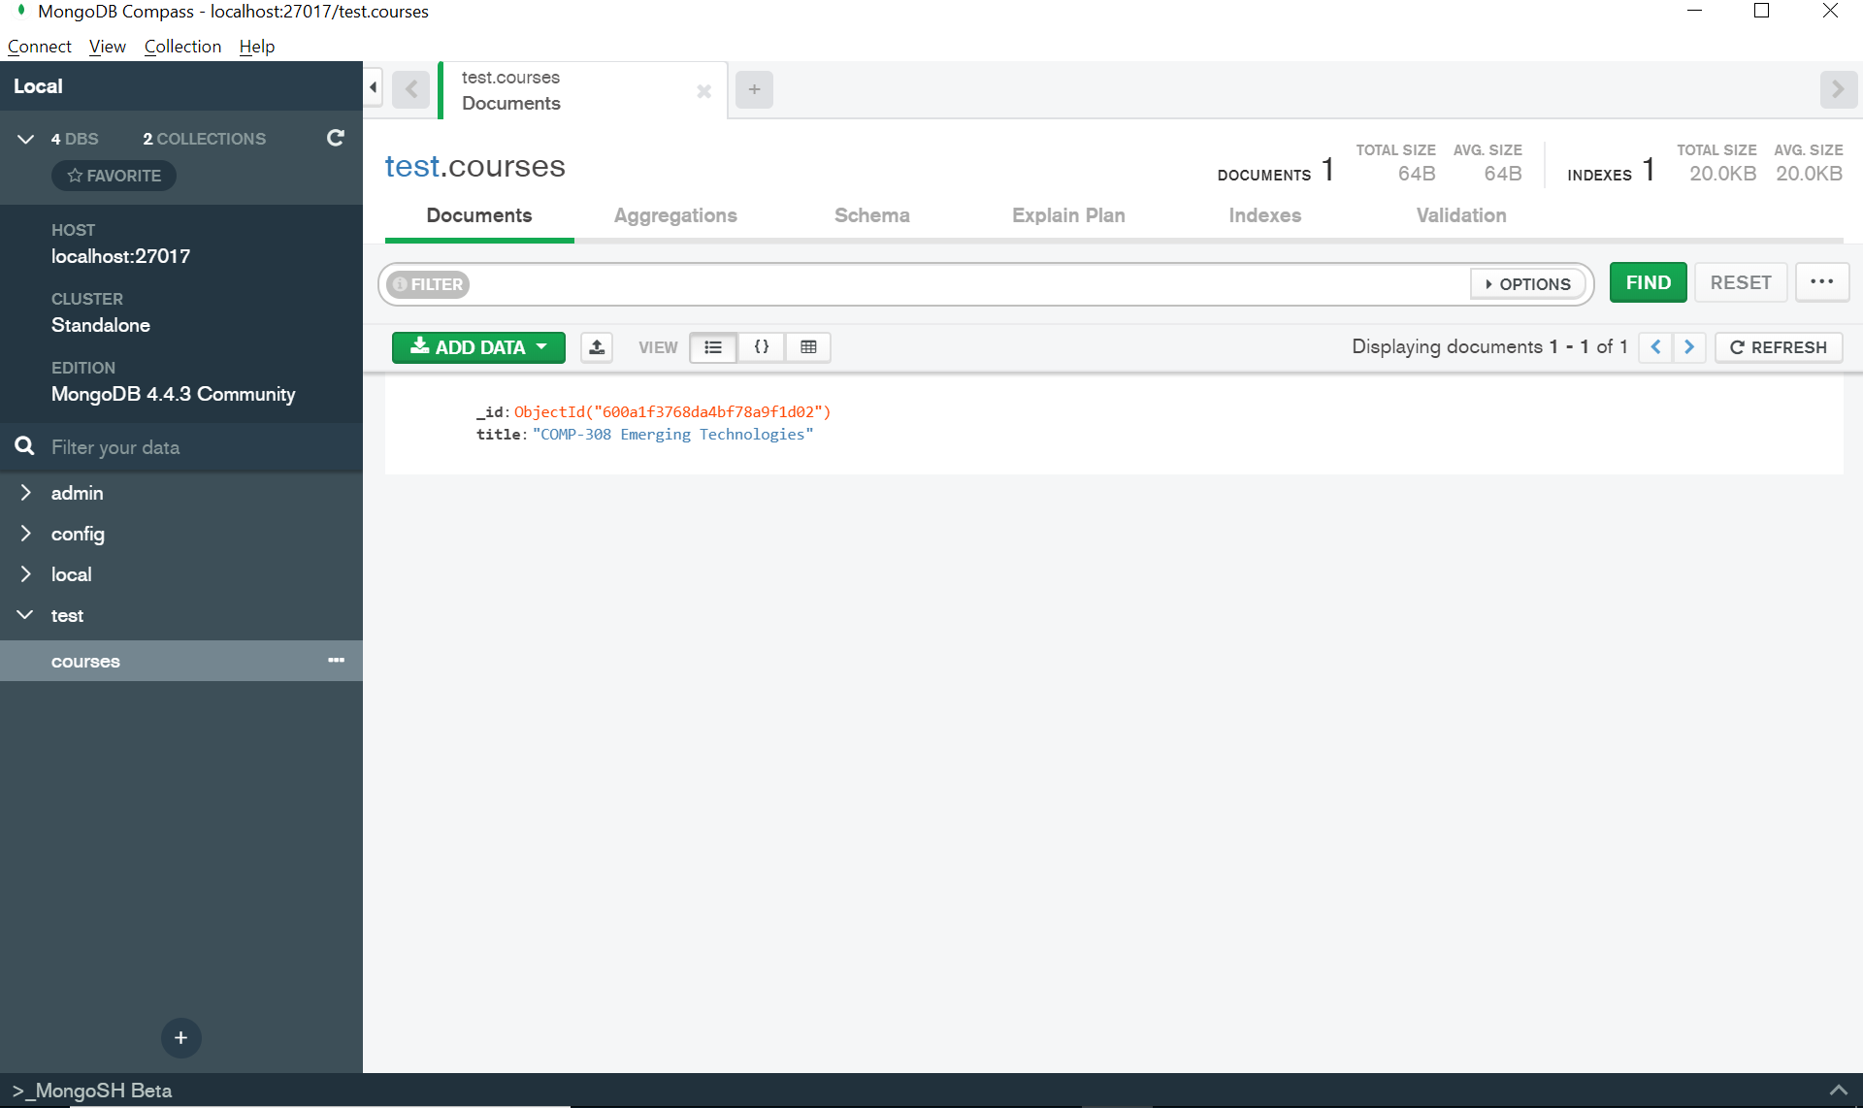
Add Documents

Slide 30
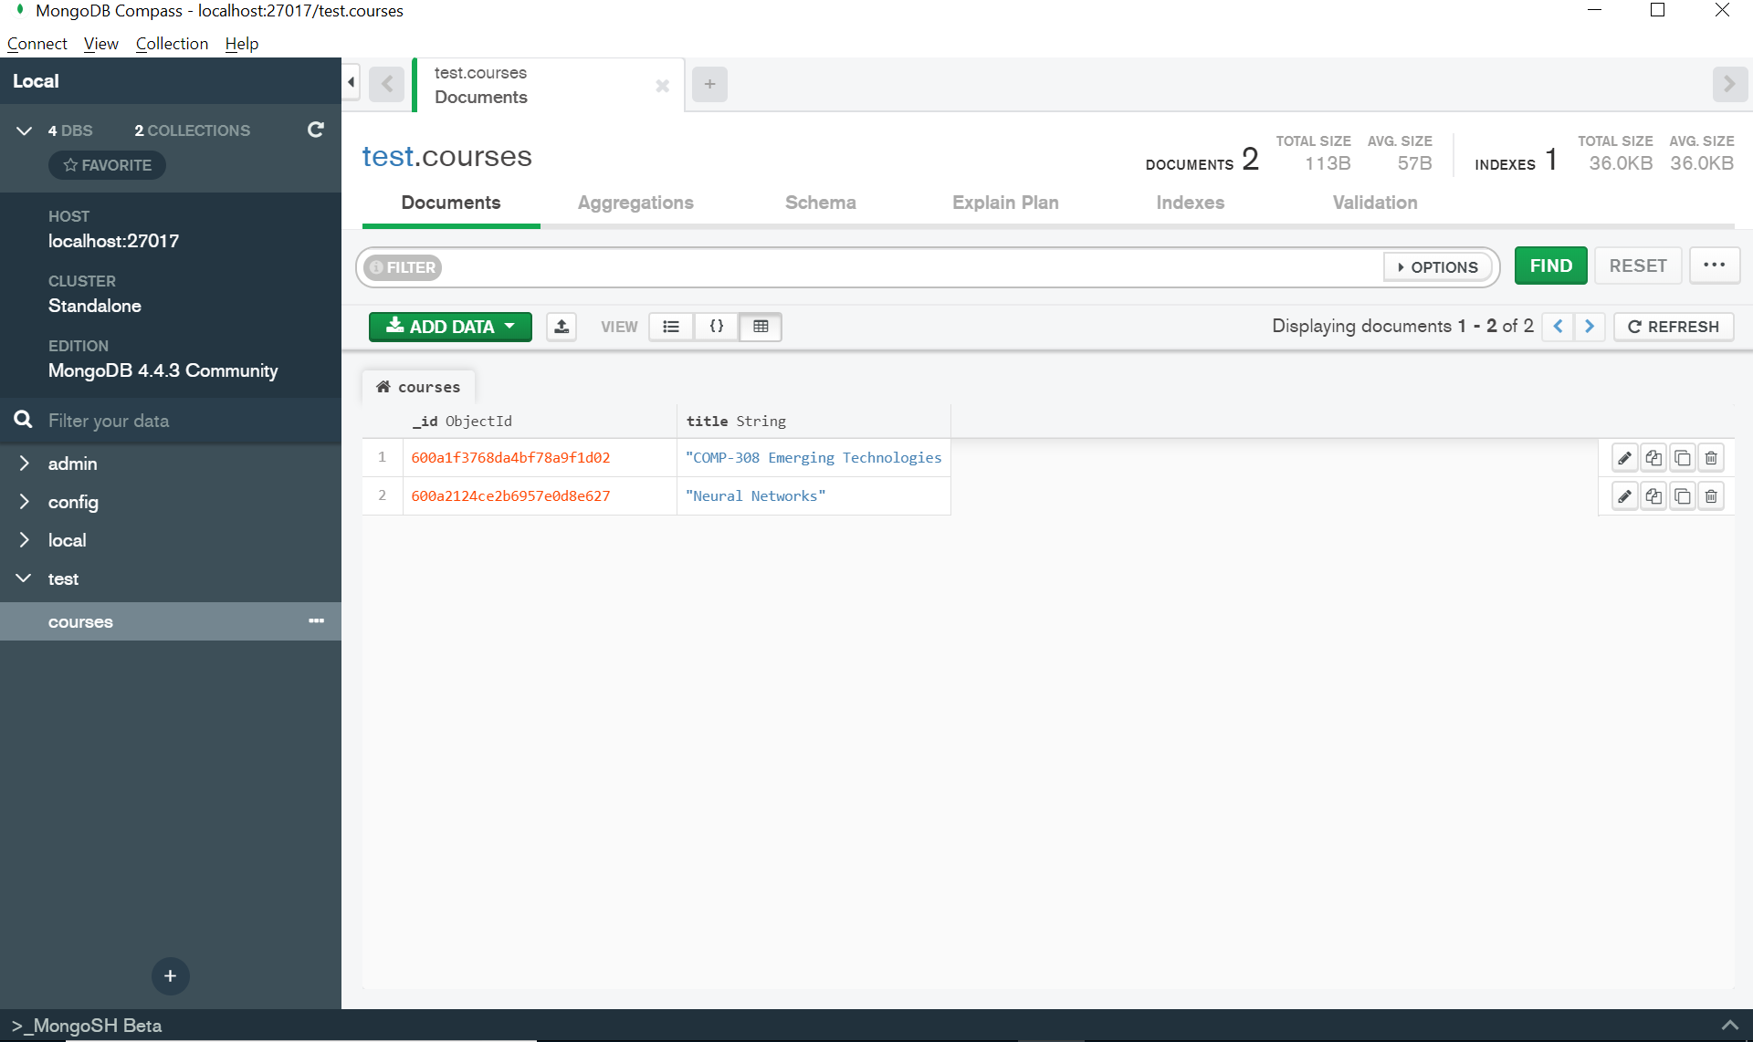
Add Documents

Slide 31
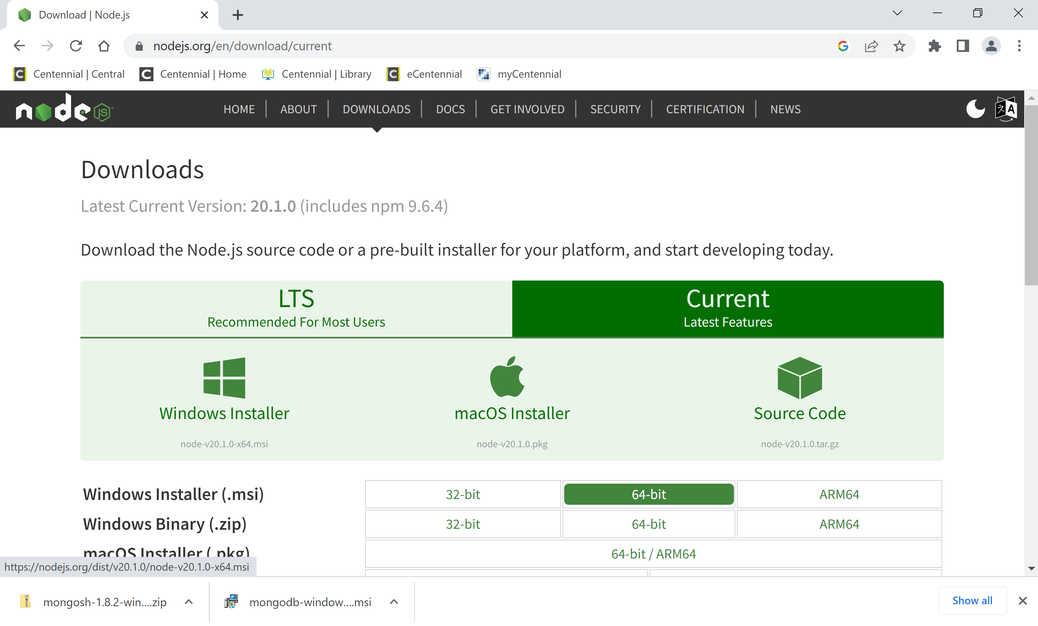
Installing Node.js

Slide 32
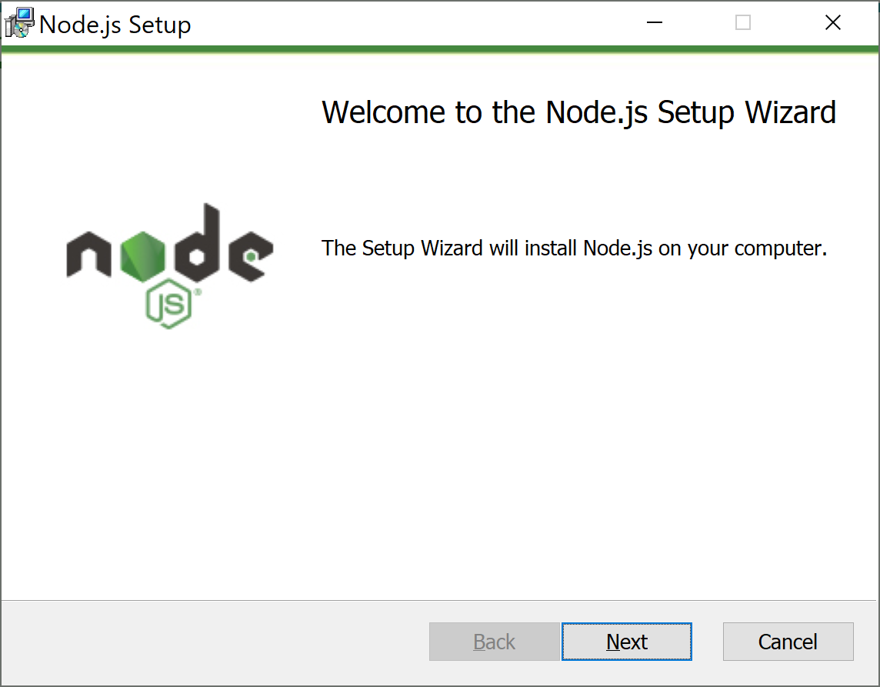
Installing Node.js
Install 64bit node-v20.1.0-x64.msi file.

Slide 33
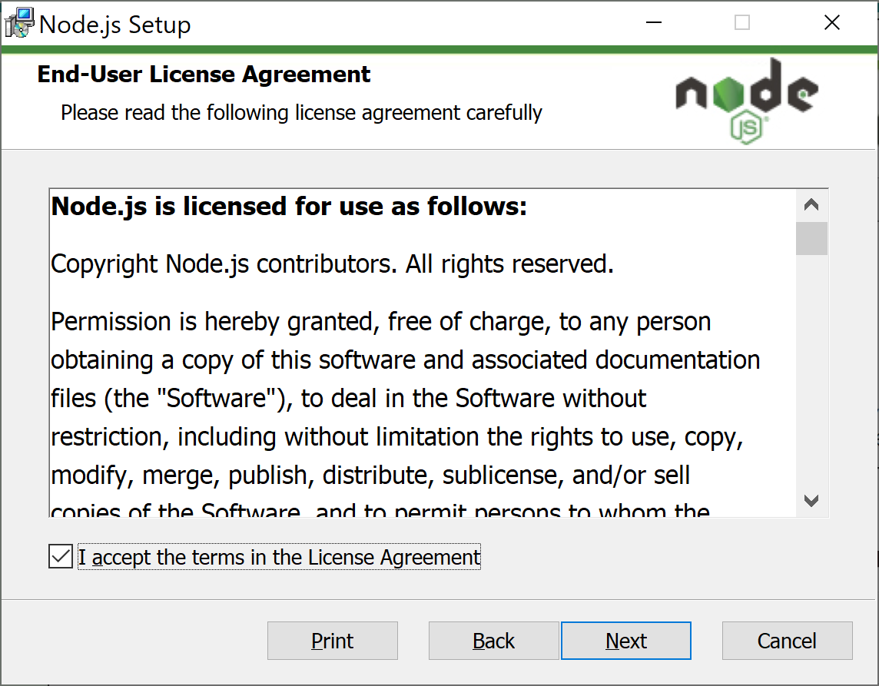
Installing Node.js

Slide 34
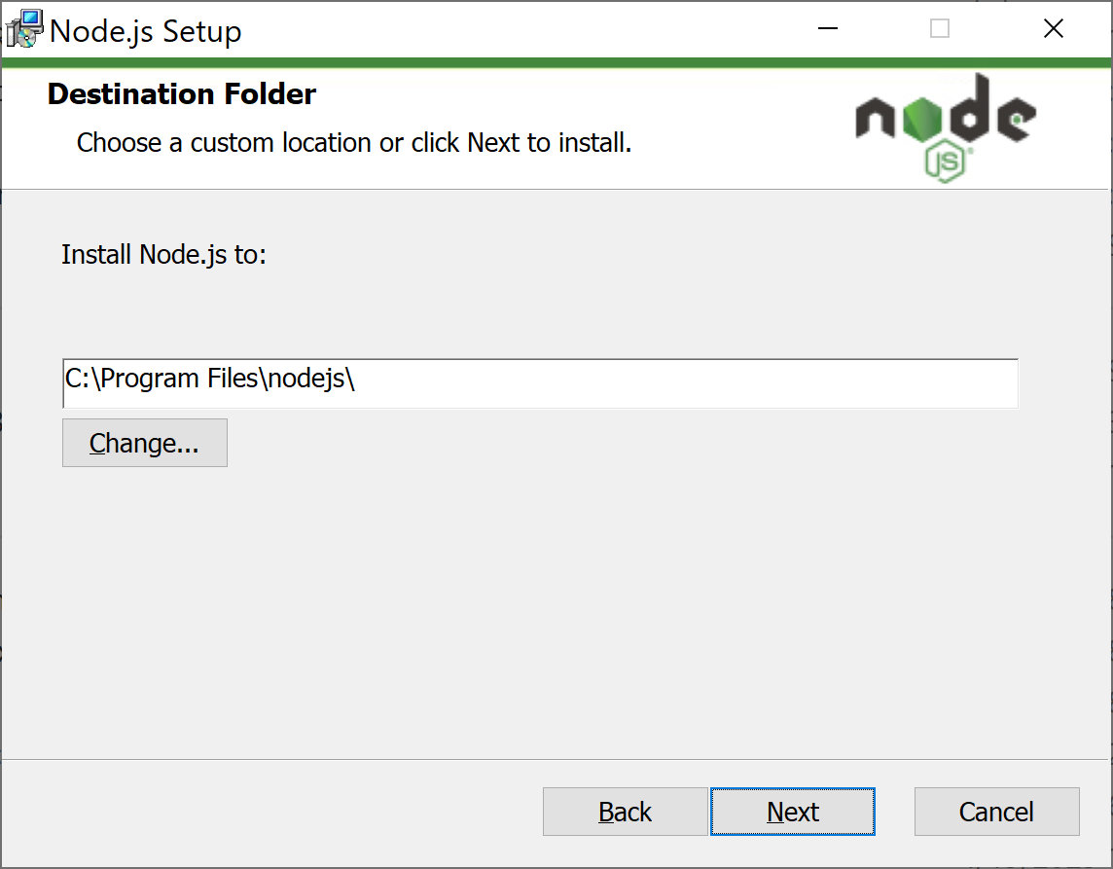
Installing Node.js

Slide 35
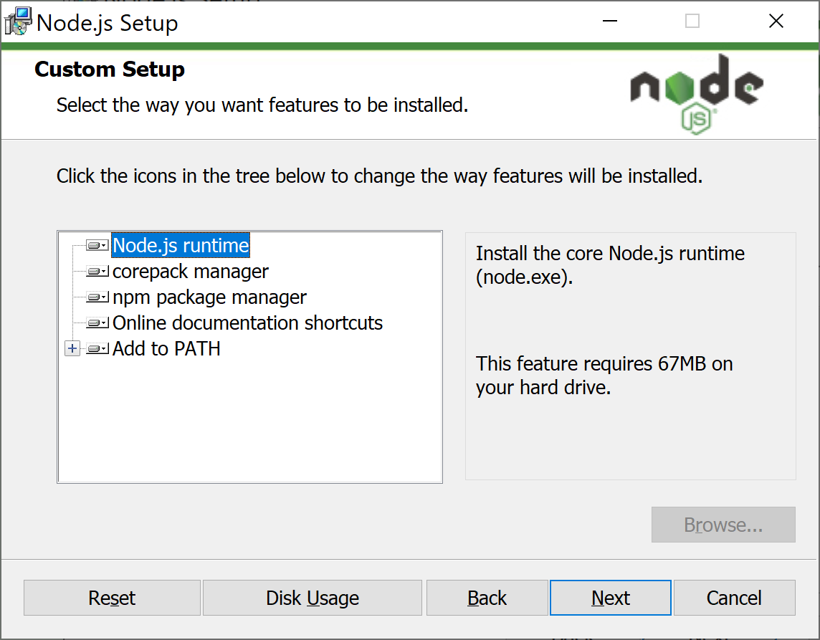
Installing Node.js

Slide 36
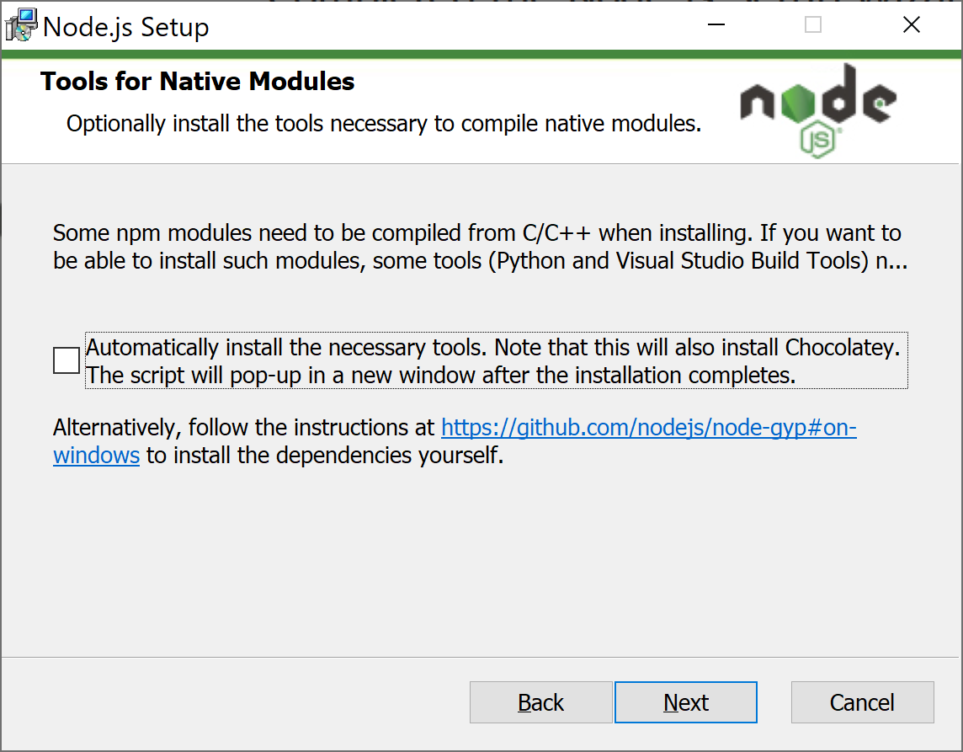
Installing Node.js

Slide 37
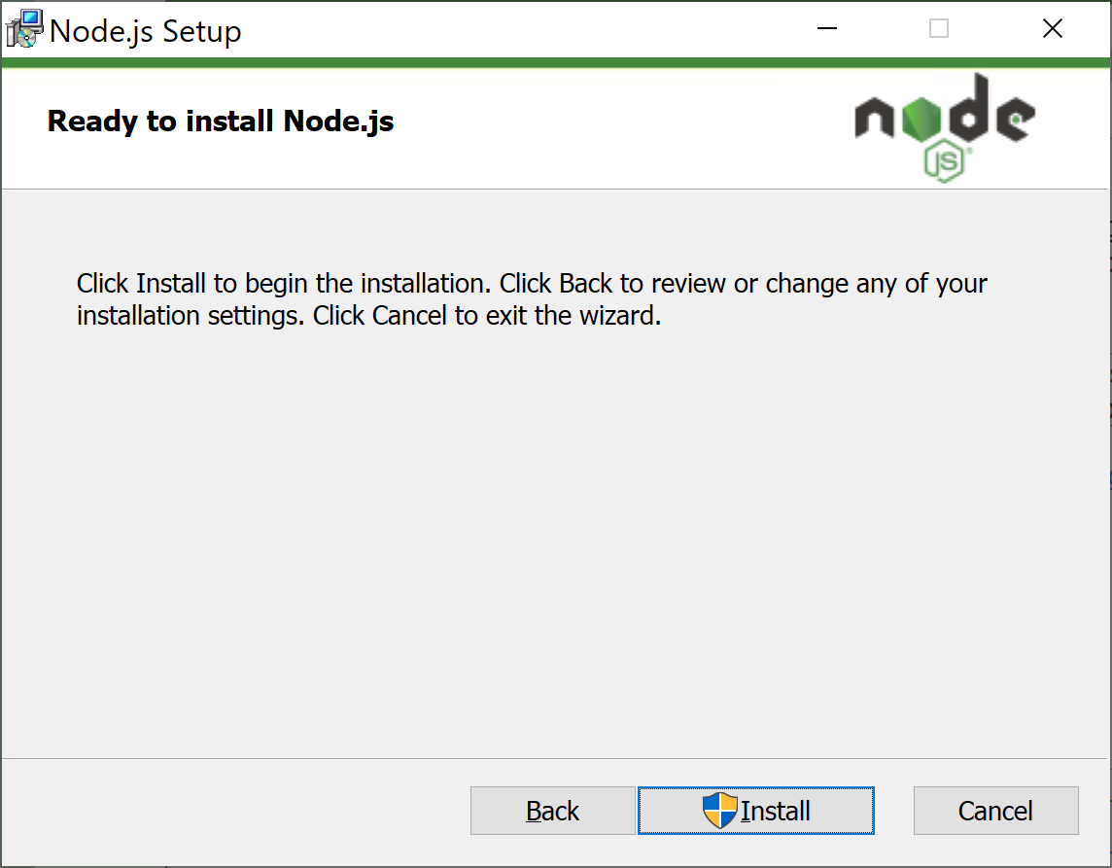
Installing Node.js

Slide 38
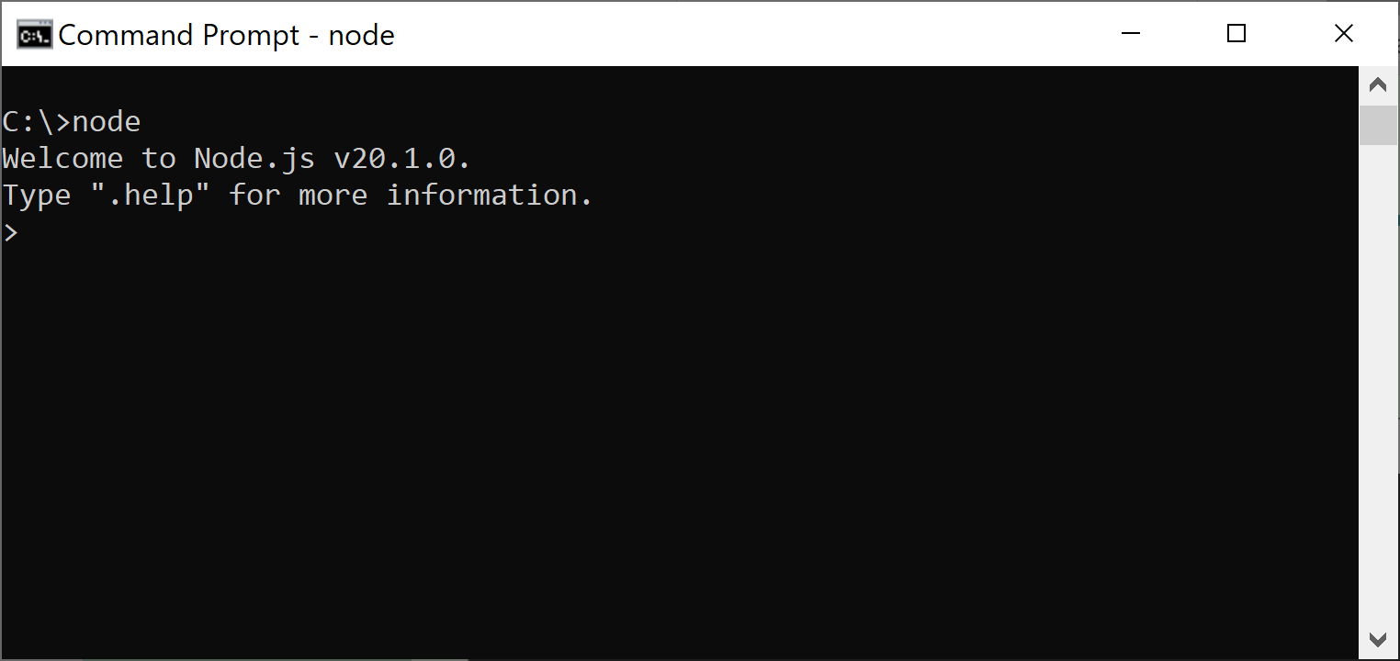
Running Node.js
Just run node from command prompt:

Slide 39
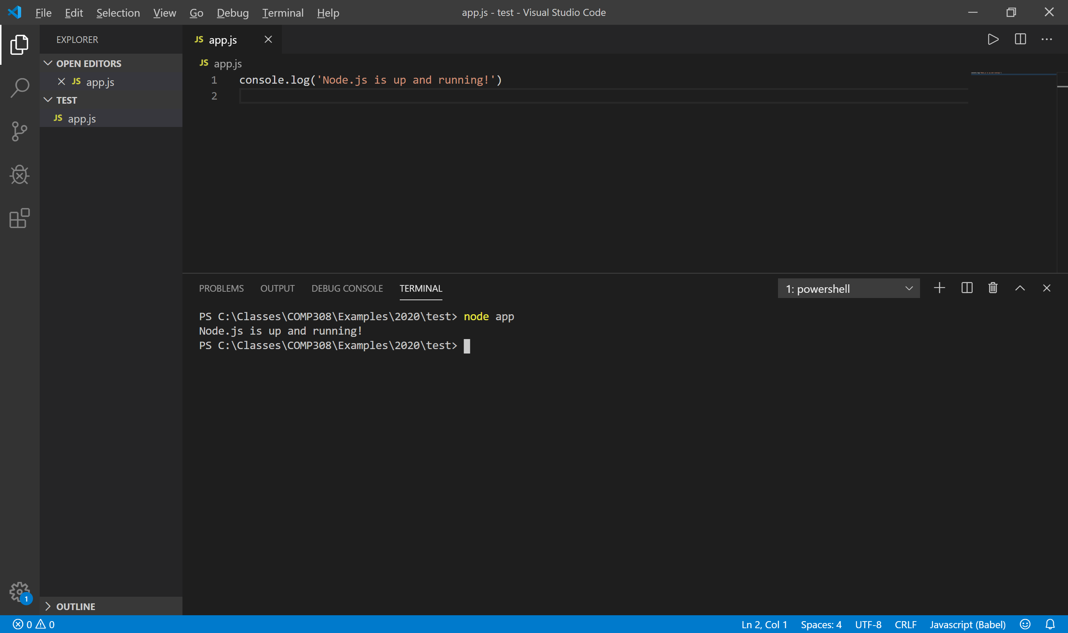
Running Node.js
Create a JavaScript file app.js with this line:
console.log(‘Node.js is up and running!’);

Slide 40
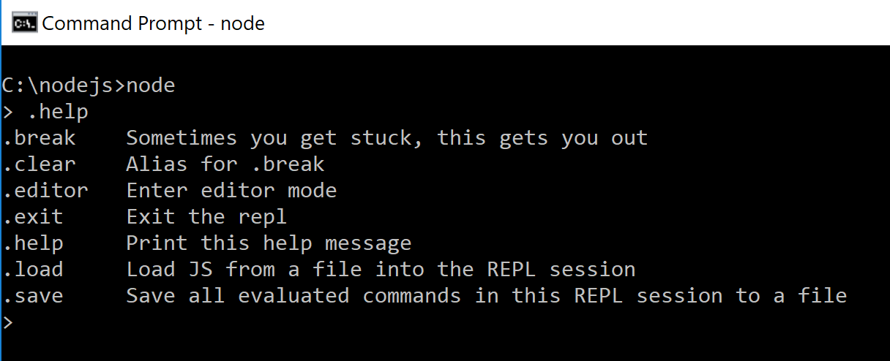
Node.js prompt commands

Slide 41
Node Package Manager
NPM is the best way to install, update, and remove Node.js modules
NPM has the following main features:
A registry of packages to browse, download, and install third-party modules
A CLI tool to manage local and global packages
NPM is installed during the Node.js installation process.

Slide 42
Using NPM
NPM has two installation modes: local and global.
The default local mode is used more often and installs the third-party packages in a local node_modules folder placed inside your application folder.
It has no effect system-wise, and is used to install the packages your application needs, without polluting your system with unnecessary global files.
The global mode is used to install packages you want Node.js to use globally.
Will demonstrate the use of NPM by installing Express

Slide 43
Using NPM
The global mode will usually install the packages in the C:\Users\%USERNAME%\AppData\Roaming\npm\node_modules folder, making it available to any Node.js application running on the system.
To install a package using the npm run the following command:
npm install <Package Unique Name>
Installing a module globally is similar to its local counterpart, but you'll have to add the –g flag as follows:
npm install –g <Package Unique Name>

Slide 44
Using NPM
For example, to locally install Express, you'll need to navigate to your application folder and issue the following command:
npm install express
NPM supports a wide range of semantic versioning, so to install a specific version of a package, you can use the npm install command as follows:
npm install <Package Unique Name>@<Package Version>
For instance, to install the second major version of the Express package, you'll need to issue the following command:
npm install express@4.x

Slide 45
Using NPM
Removing a package using NPM
To remove an installed package, you'll have to navigate to your application folder and run the following command:
npm uninstall < Package Unique Name>
NPM will then look for the package and try to remove it from the local node_modules folder.
To remove a global package, you'll need to use the -g flag as follows:
npm uninstall –g < Package Unique Name>

Slide 46
Using NPM
Updating a package using NPM
To update a package to its latest version, issue the following command:
npm update < Package Unique Name>
NPM will download and install the latest version of this package even if it doesn't exist yet.
To update a global package, use the following command:
npm update –g < Package Unique Name>

Slide 47
Managing dependencies using the package.json file
NPM allows you to use a configuration file named package.json in the root folder of your application.
In your package.json file, you'll be able to define various metadata properties of your application, including properties such as the name, version, and author of your application.
This is also where you define your application dependencies.

Slide 48
Managing dependencies using the package.json file
The package.json file is basically a JSON file that contains the different attributes you'll need to describe your application properties.
An application using the latest Express and Grunt packages will have a package. json file as follows:
{
"name" : "MERN",
"version" : "0.0.1",
"dependencies" : {
"express" : "latest",
"grunt" : "latest"
}
}

Slide 49
Creating a package.json file
While you can manually create a package.json file, an easier approach would be to use the npm init command.
To do so, use your command-line tool and issue the following command:
$ npm init
NPM will ask you a few questions about your application and will automatically create a new package.json file for you.
A sample process should look similar to the following screenshot:

Slide 50
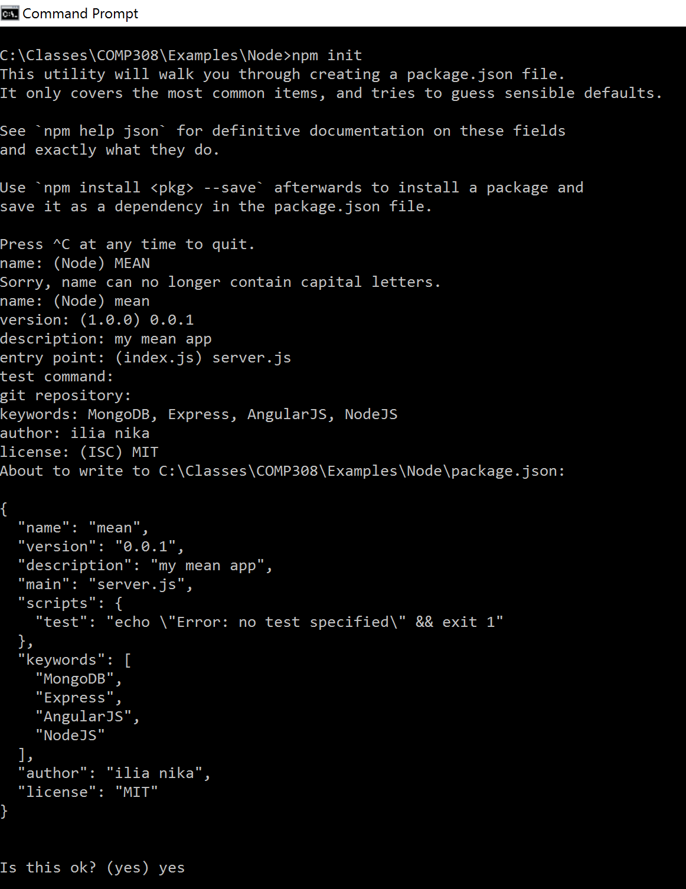
Creating a package.json file

Slide 51
Installing the package.json dependencies
After creating your package.json file, you'll be able to install your application dependencies by navigating to your application's root folder and using the npm install command as follows:
npm install
NPM will automatically detect your package.json file and will install all your application dependencies, placing them under a local node_modules folder.
An alternative and sometimes better approach to install your dependencies is to use the following npm update command:
npm update

Slide 52
Updating the package.json file
Another robust feature of the npm install command is the ability to install a new package and save the package information as a dependency in your package.json file.
This can be accomplished using the --save optional flag when installing a specific package.
For example, to install the latest version of Express and save it as a dependency, you can issue the following command:
npm install express --save

Slide 53
Creating Node.js Apps in VS Code
Write a simple Node.js app in VS Code.
See the video on eCentennial.
Test Week 1 Examples
Complete the Lab Session 1
Complete Interactive Exercise 1

Slide 54
References
Reference textbook
https://nodejs.org/en/
http://expressjs.com/
https://angular.io/
https://www.mongodb.org/
https://code.visualstudio.com/

